Slide 1

Deploying Microsoft Azure Stack Hub
Azure Stack Hub Deployment Prerequisites
This work is licensed under a Creative Commons Attribution - ShareAlike 4.0 International Public License

Slide 2
Agenda
Introduction
Azure Stack Hub deployment prerequisites
Data collection
Configuration data required for deployment
Networking
IP configuration, subnets, BGP, etc.
Deployment mode
AAD vs. ADFS
Other prerequisites

Slide 3
Introduction

Slide 4
Collecting the Deployment Information
Previously, the OEM would collect information from each customer in a spreadsheet
The spreadsheet would produce configuration files that would feed the automated deployment script and fill in the names, IP ranges, BGP routing details, everything needed to perform a fully automated configuration of Azure Stack Hub
New! This has been replaced by a PowerShell-based UI that can collect the same information and produce the same output file data

Slide 5
Deployment Information: PowerShell UI
You will be able to download the PowerShell tool from the web​
Available directly to customers (may be customized by OEMs)​
Only PowerShell UI. Still must match Azure Stack Hub PowerShell Toolkit version​
Customers can save/export with downloadable ‘gallery’ version and open/import with OEM customized version​
The PowerShell tool can open configurations saved by the deployment spreadsheet – it is backwards compatible

Slide 6
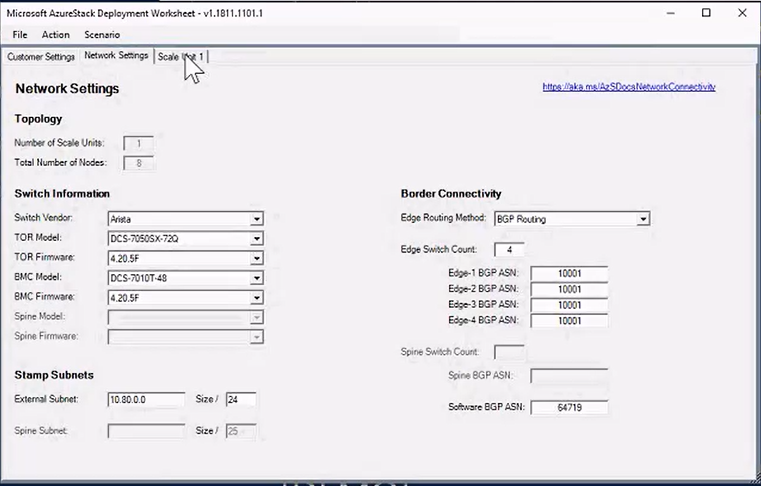
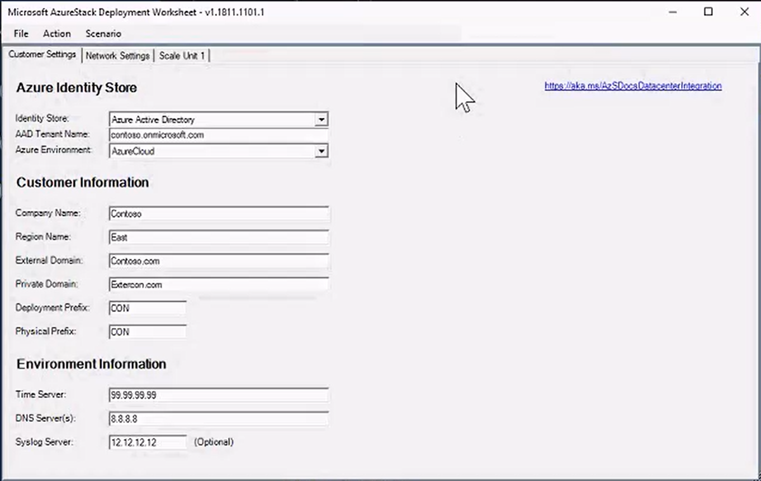
Using the PowerShell UI
Fill in the forms, generate the settings file data

Slide 7
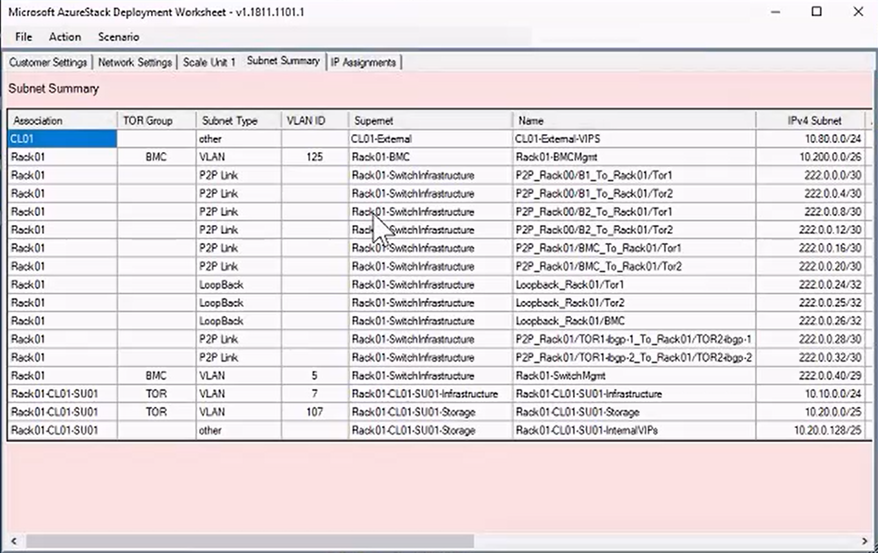
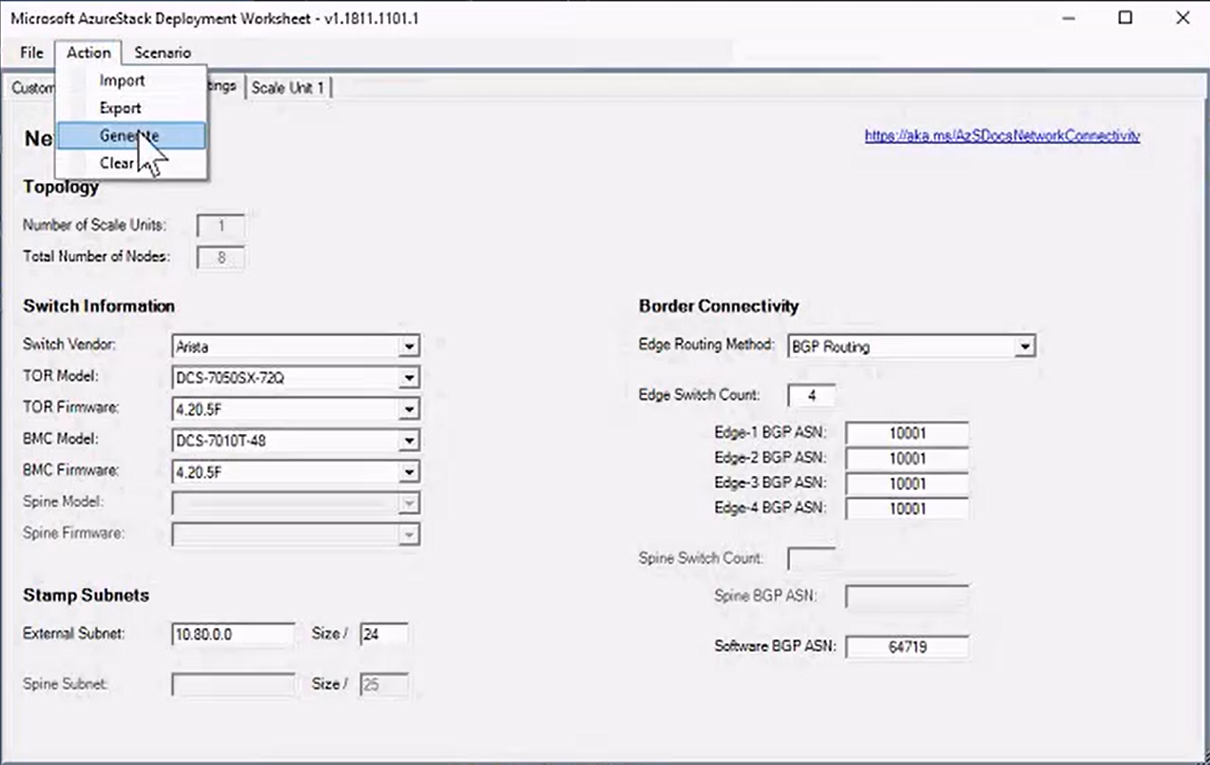
Using the PowerShell UI
Fill in the forms, generate the settings file data

Slide 8
Typical datacenter integration touchpoints
IPv4
Network
Firewall
Identity
SSL
IP Space
Uplink
Publishing Rules
AAD / ADFS
SSL Certificates
Post-Deployment Configuration
DNS
NTP
Device Auth.
Syslog
ITSM /
Security
DNS
Time Server
Radius/TACAS*
Syslog Server*
ITSM Integration*

Slide 9
Firewall: Port requirements
Azure Stack Hub does not currently have a configurable setting to identify a proxy server.
You must have direct Internet access or a proxy that requires no client configuration
Customer FW
Customer Border Device
TOR & BMC (ACL Lockdown Infrastructure, Storage)
ACL
ACL
ACL
SDN
Infrastructure External
Infrastructure Internal
Tenant External
VIP
VIP
VIP
DIP
DIP
DIP
DIP
DIP
DIP

Slide 10
Edge deployment
A network firewall is a recommended way to protect the Azure Stack Hub
Azure Stack Hub uses ACLs for the VIPs and Physical Switches
This shows how Azure Stack Hub is connected to an existing edge firewall
Agg / Edge Router
Firewall
ToR
BMC
ToR
Private
Storage & Infra VIPs
(10.11.128.0/24)
Private
Infrastructure Services
(10.11.130.0/24)
Service VIPs
Tenant VIPs
Public VIPs (65.53.123.0/22)
Azure Stack Hub
Firewall/NAT/Proxy
Intranet Networks

Slide 11
Enterprise/intranet/DMZ
Traditional enterprise deployment with DMZ between internal network and Internet
Options for connecting Azure Stack Hub to the DMZ are through firewall, NAT, and reverse proxy
Agg / Edge Router
Firewall
DMZ
Firewall/NAT/Proxy
ToR
BMC
ToR
Private
Storage & Infra VIPs
(10.11.128.0/24)
Private
Infrastructure Services
(10.11.130.0/24)
Service VIPs
Tenant VIPs
Public VIPs (65.53.123.0/22)
Azure Stack Hub

Slide 12
Certificate requirements for infrastructure VIPs
Issued by a public trusted CA or Enterprise CA
Used for all VIPs that are external facing (registered in an external DNS Zone)
Required at deployment time (PFX format)
Support for Wildcard certificates
Rotation via PEP (Privileged Endpoint)
adfs and graph certificates only needed when Azure Stack Hub uses ADFS for identity
https://docs.microsoft.com/en-us/azure/azure-stack/azure-stack-pki-certs
adminportal.<region>.<fqdn> | portal.<region>.<fqdn>
adminmanagement.<region>.<fqdn> | management.<region>.<fqdn>
*.blob.<region>.<fqdn> | *.table.<region>.<fqdn>
*.queue.<region>.<fqdn>
*.adminvault.<region>.<fqdn> | *.vault.<region>.<fqdn>
adfs.<region>.<fqdn> | graph.<region>.<fqdn>
*.adminhosting.<region>.<fqdn> | *.hosting.<region>.<fqdn>

Slide 13
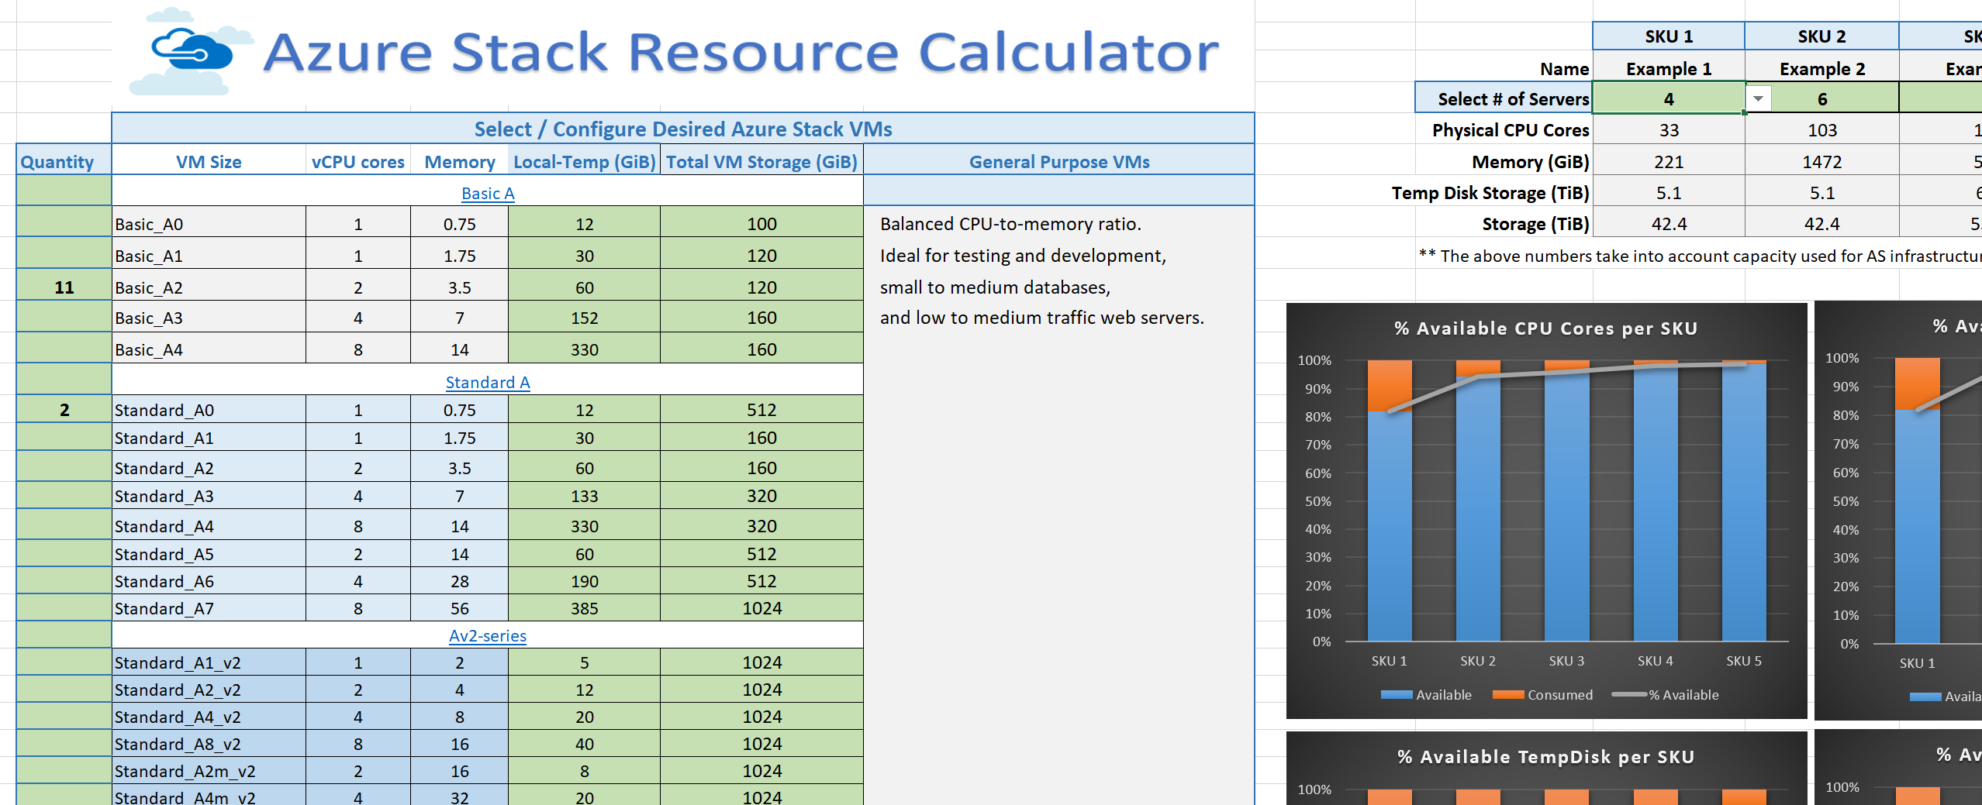
Azure Stack Hub Capacity Planning Tool
Downloadable tool where Azure Stack Hub customers fill in some variables and arrive at an appropriate scale for their Azure Stack Hub initial hardware - https://gallery.technet.microsoft.com/Azure-Stack-Capacity-24ccd822

Slide 14
Networking prerequisites

Slide 15
Subnet name
Subnet size
Infrastructure
/24
Storage
/25
BMC
/26
Switch Mgmt
/26
Public VIP
/26 - /22
Advertised as individual /32s
Private VIP
/25
Advertised as individual /32s

Slide 16
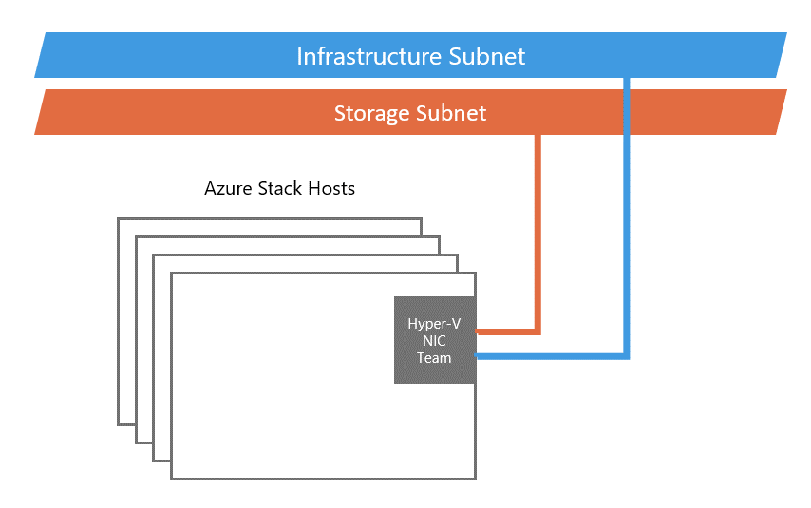
Networking prerequisites – Infrastructure net
Infrastructure networks
Storage network and internal VIPs
Used for S2D, SMB, and Virtual Machine live migration
Infrastructure network
Dedicated network for internal Azure Stack Hub components

Slide 17
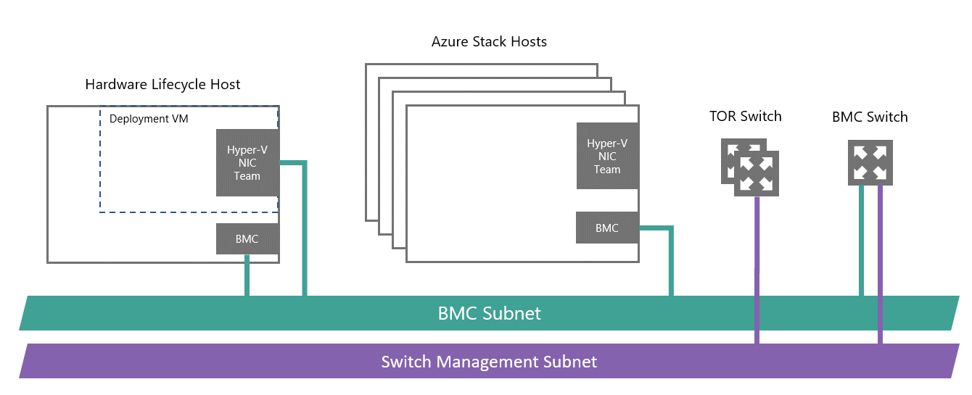
Networking prerequisites – BMC net
BMC network
Dedicated to connecting all the baseboard management controllers
Used to control physical server power on/off sequences for OS installation
Also provide connectivity to the DVM
Switch management
Out-of-band access for deployment, management, and troubleshooting

Slide 18
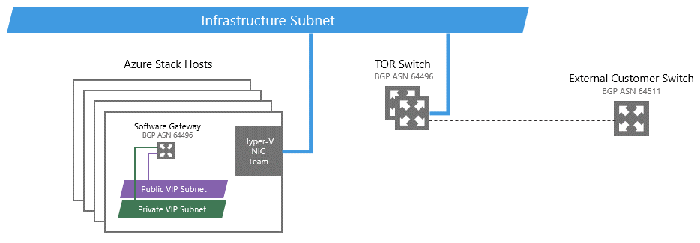
Networking prerequisites – Public net
Public Virtual IP (VIP) Networks
Contains the external-accessible or public IP addresses
Private Virtual IP Networks

Slide 19
Networking prerequisites – Border Gateway Protocol
BGP configuration
Edge Switch, ToR Switch, and Software BGP ASN
ToR Switch BGP Peer IP Addresses
Infrastructure Extended Network
Syslog Server (optional)

Slide 20
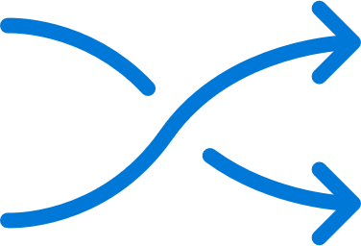




Networking integration considerations
Time server specified at deployment but also used for physical network switches:
Time across all infrastructure elements is key
This time is propagated to the whole solution (including user VMs)
Supports existing logging infrastructure for:
Physical network switches
Baseboard management controller
OEM tools
Supports existing infrastructure of:
Radius with MSCHAPv2
TACACS
External firewall recommended
Between Azure Stack Hub and Internet
Protect against unwanted incoming traffic

Slide 21

Connected or disconnected
This is a key decision point! Choosing whether your Azure Stack Hub deployment is connected or not connected to Azure is a one-time decision that you must make at deployment time, and cannot change later on without re-deploying the solution.

Slide 22
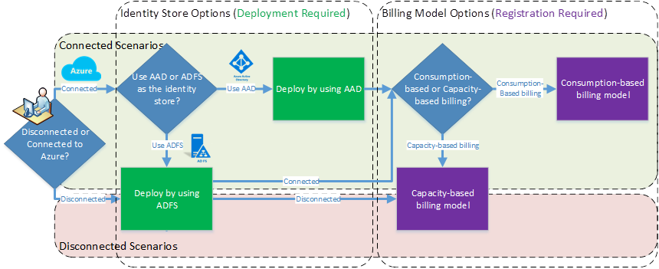
Connected or disconnected?

Slide 23
Connected or disconnected?
Connected
Consumption or capacity-based
AAD or ADFS
Disconnected
Capacity-based
ADFS only

Slide 24
Connected scenarios
Prerequisites
Provides a choice between identity source types:
Active Directory Federation Services (AD FS) (no multi-tenancy)
Azure Active Directory (AAD) for your identity store
Requires two AAD accounts:
The first one is used to create applications and service principals for infrastructure services
The second one is used to establish the billing relationship with the Azure commerce back-end
Note: The two accounts can be the same account, or can be completely different accounts.

Slide 25
Disconnected scenarios
Prerequisites
Constrained to a single identity source type:
Active Directory Federation Services (ADFS)
Graph Service
The Graph service requires a service account with read-only access to the target Active Directory forest.
The Graph service can only communicate with a single Active Directory Domain Services (AD DS) forest.
The Graph service requires access to a AD DS global catalog server.
Limitations
No multi-tenancy with ADFS
Some features are impaired or unavailable.
Note: Choosing “Do not connect to Azure” does not strictly mean that you cannot connect your Azure Stack Hub instance to Azure for hybrid scenarios for tenant workloads

Slide 26
Feature summary: Deploying with ADFS
 | Physically disconnected | Physically connected
Identity | Must be ADFS | AAD or ADFS
Billing | Must be capacity EA only | Capacity or consumption EA or CSP
Marketplace syndication | Not supported | Supported BYOL licensing
Registration | Recommended, requires removable media and a separate connected device | Automated
P&U | Required, requires removable media and a separate connected device | Required, requires removable media and a separate connected device
Features that are impaired or unavailable in disconnected deployments
https://docs.microsoft.com/en-us/azure/azure-stack/azure-stack-disconnected-deployment

Slide 27
Crucial Decisions

Slide 28
If you choose incorrectly, you need to redeploy
Identity
Azure AD gives you better hybrid identity integration. This is preferred.
You cannot change the primary/default Azure AD tenant you used after deployment. You can add more tenants, but you cannot change the primary one.
If you are physically disconnected, you must choose ADFS
Performance
The CPU family cannot change as you add nodes to a scale unit
Consider disk IOPS – this can be improved by adding flash storage – refer to the OEM for details

Slide 29
Questions?

